Slide 1

Project Amalgam
KPI Dashboard Webpage

Slide 2
Website Framing (Level 1)
Tier 3: KQI Mobile Broadband
Tier 1
Customer Perception
Tier 2
Customer Experience
(NQI, CLI)
Tier 2
Customer Experience
(CC)
Tier 3: KQI Mobile Voice / SMS
Tier 2
Customer Experience
(V3D Network-wide)
Tier 2
Customer Experience
(V3D VIP)
Tier 3
Service KQI
Tier 3: KQI Wireline
Tier 3
Traffic Performance
Tier 3
Network
Devices
Tier 4
Platform KPIs

Slide 3
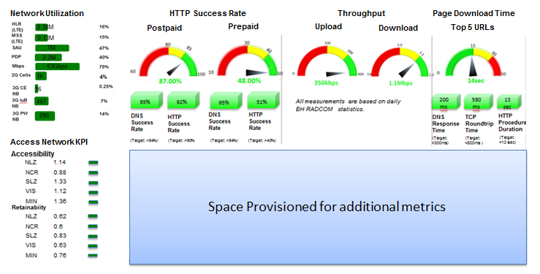
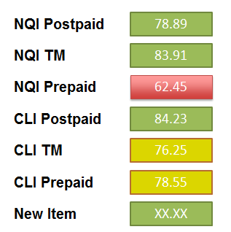
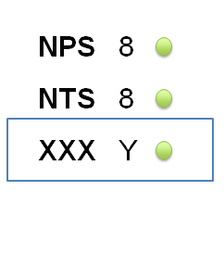
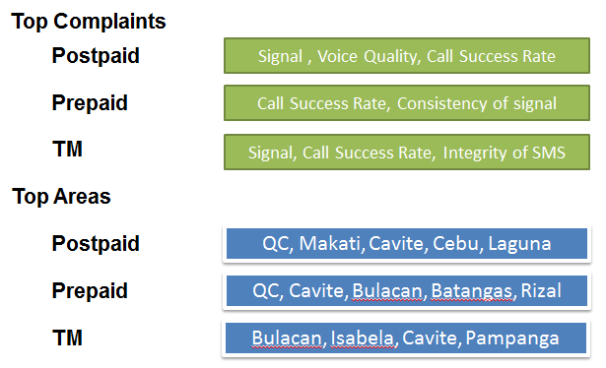
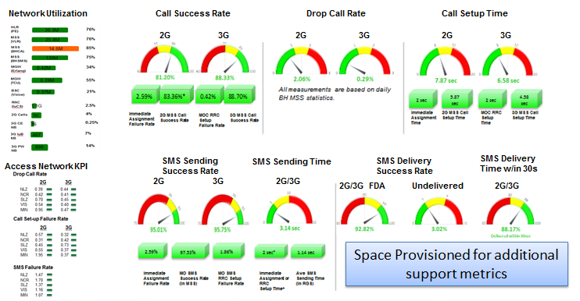
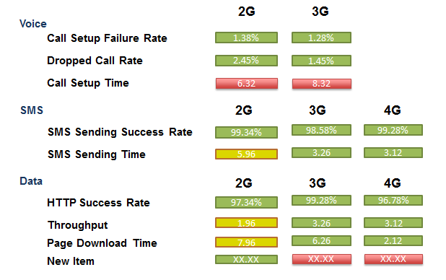
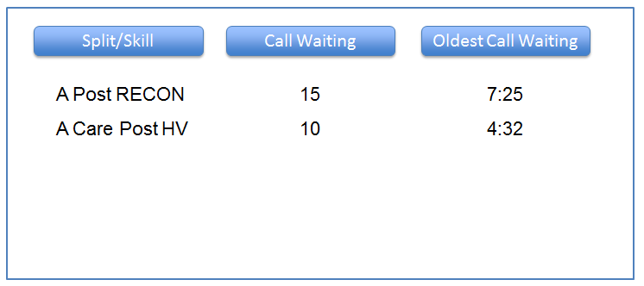
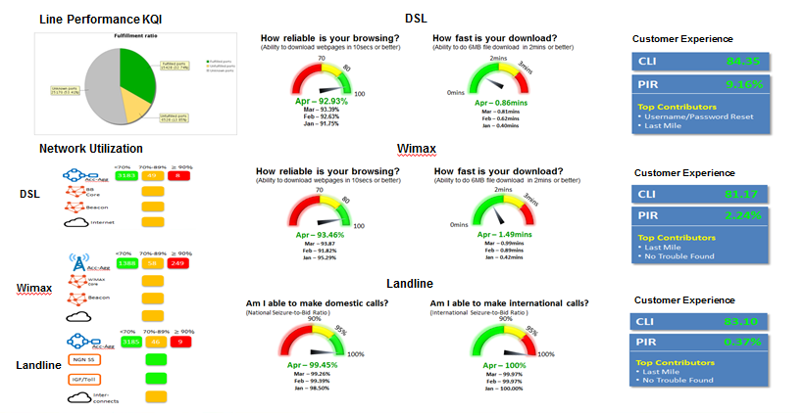
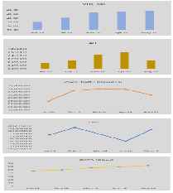
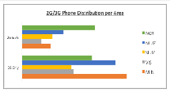
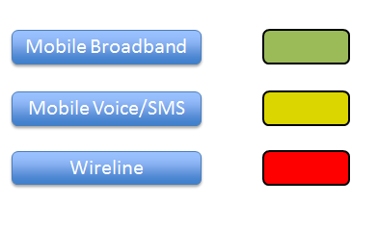
KQI: Mobile Data
Customer Perception
Customer Experience
Customer Complaints
KQI: Mobile Voice & SMS
V3D (Network-wide)
V3D VIP
CC Stats
Traffic Performance
Network Devices
Platform KPIs
KQI: Wireline

Slide 4
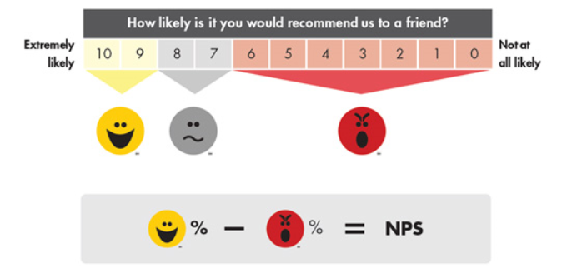
Tier1: Customer Perception
NPS
8
NTS
8
XXX
Y
New items can easily be added

Slide 5
Tier2: Customer Experience
NQI Postpaid
78.89
NQI TM
83.91
NQI Prepaid
62.45
CLI Postpaid
84.23
CLI TM
76.25
CLI Prepaid
78.55
New Item
XX.XX
New item can easily be added

Slide 6
Tier2: Customer Experience - CC
Top Complaints
Postpaid
Signal , Voice Quality, Call Success Rate
Prepaid
Call Success Rate, Consistency of signal
TM
Signal, Call Success Rate, Integrity of SMS
Top Areas
Postpaid
QC, Makati, Cavite, Cebu, Laguna
Prepaid
QC, Cavite, Bulacan, Batangas, Rizal
TM
Bulacan, Isabela, Cavite, Pampanga

Slide 7
Tier2: V3D (Network-wide & VIP)
2G
3G
Voice
Call Setup Failure Rate
1.38%
1.28%
Dropped Call Rate
2.45%
1.45%
Call Setup Time
6.32
8.32
SMS
2G
3G
4G
SMS Sending Success Rate
99.34%
98.58%
99.28%
SMS Sending Time
5.96
3.26
3.12
Data
2G
3G
4G
HTTP Success Rate
97.34%
99.28%
96.78%
Throughput
1.96
3.26
3.12
Page Download Time
7.96
6.26
2.12
New Item
XX.XX
XX.XX
XX.XX
New item can easily be added

Slide 8
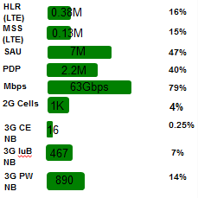
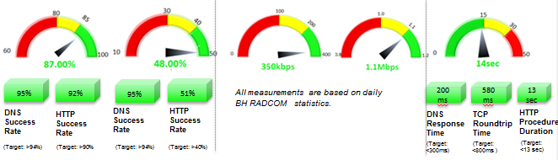
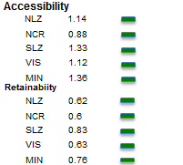
Tier 3: KQI Mobile Data
NOTE: Color Coded
Network Utilization
HTTP Success Rate
Throughput
Page Download Time
Postpaid
Prepaid
Upload
Download
Top 5 URLs
Access Network KPI
Space Provisioned for additional metrics

Slide 9
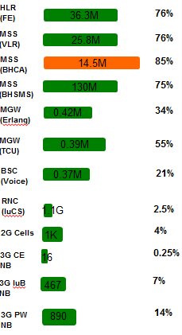
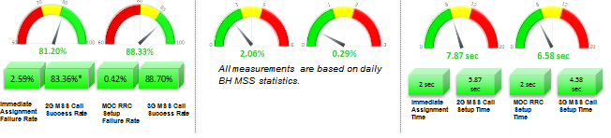
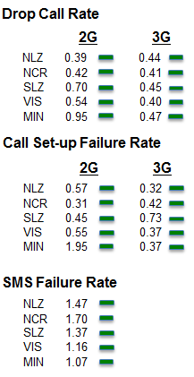
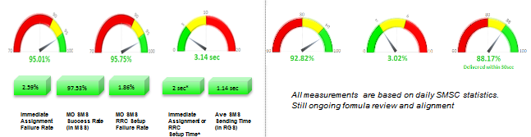

Tier 3: KQI Mobile Voice & SMS
Network Utilization
Call Success Rate
Drop Call Rate
Call Setup Time
2G
3G
2G
3G
2G
3G
Access Network KPI
SMS Sending
Success Rate
SMS Sending Time
SMS Delivery
Success Rate
SMS Delivery
Time w/in 30s
2G
3G
2G/3G
2G/3G FDA
Undelivered
2G/3G
Space Provisioned for additional support metrics

Slide 10
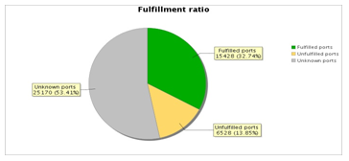
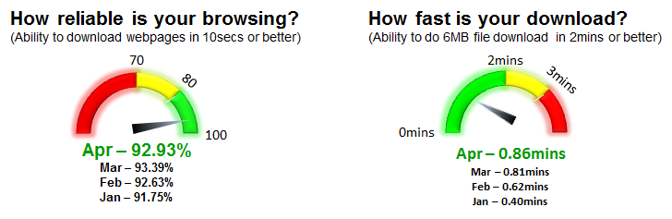
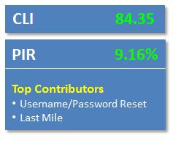
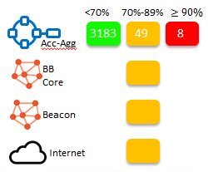
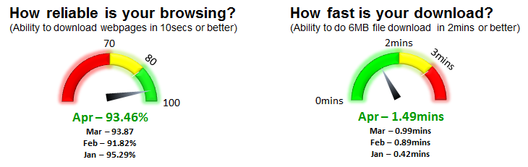
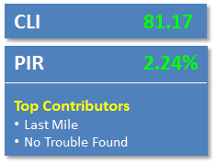
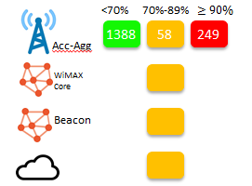
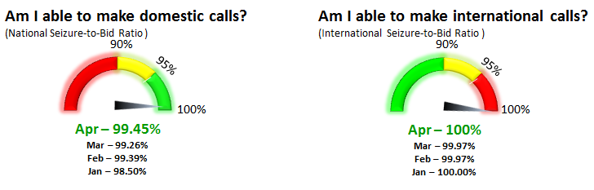
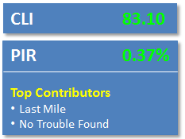
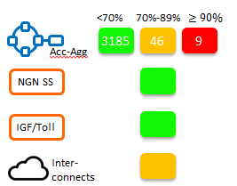
Tier 3: KQI Wireline
Line Performance KQI
DSL
Customer Experience
Network Utilization
Wimax
Customer Experience
DSL
Wimax
Landline
Customer Experience
Landline

Slide 11
Tier 4: Key Performance Indicators
Mobile Broadband
Mobile Voice/SMS
Wireline

Slide 12
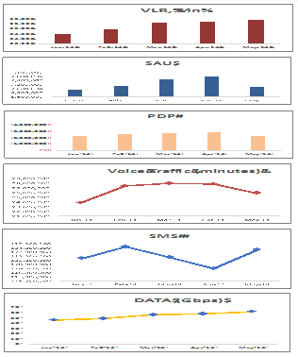
Tier 3: Traffic Performance

Slide 13
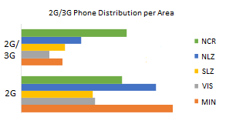
Tier 3: Network Devices

Slide 14
Tier 2: CC Stats
Split/Skill
Call Waiting
Oldest Call Waiting
A Post RECON
15
7:25
A Care Post HV
10
4:32
NOTE: Top 10 Highest breaching 4 call waits.

Slide 15


Slide 17
Tier 3: KQI Mobile Data
Network Utilization
HTTP Success Rate
Throughput
Page Download Time
Postpaid
Prepaid
Upload
Download
Top 5 URLs
Access Network KPI
Space Provisioned for additional metrics

Slide 18
Tier 3: KQI Mobile Voice & SMS
Network Utilization
Call Success Rate
Drop Call Rate
Call Setup Time
2G
3G
2G
3G
2G
3G
Access Network KPI
SMS Sending
Success Rate
SMS Sending Time
SMS Delivery
Success Rate
SMS Delivery
Time w/in 30s
2G
3G
2G/3G
2G/3G FDA
Undelivered
2G/3G
Space Provisioned for additional support metrics

Slide 19
Tier 3: KQI Wireline
Line Performance KQI
DSL
Customer Experience
Network Utilization
Wimax
Customer Experience
DSL
Wimax
Landline
Customer Experience
Landline

